Slide 1
Introduction to Cost Accounting
--------------Suchandra Bose

Slide 2
What is Cost?
Cost is a foregoing, measured in monetary terms, incurred or potentially to be incurred to achieve a specific objective. Cost can be termed as the amount of resources given up in exchange for some goods or services.

Slide 3
What is Costing?
The technique and process of ascertaining costs is known as Costing.

Slide 4
Cost Accountancy
Cost Accountancy includes, Costing and Cost Accounting. Cost Accountancy is the application of costing and cost accounting principles, methods and techniques to the science, art and practice of cost control and the ascertainment of profitability.

Slide 5
Cost Accounting
Cost accounting accounts for the costs of a product, a service or an operation. It is concerned with actual costs incurred and the estimation of future costs. Cost accounting is a conscious and rational procedure used by accountants for accumulating costs and relating such costs to specific products or departments for effective management action.

Slide 6
Nature and Characteristics of Cost Accounting
Specialised Branch of Accounting
Art and Science Both
Recognised as a Profession
Determination of various Components of Total Cost
Application of Statistical Data of Computing Profit and Cost

Slide 7
Scope of Cost Accounting
The scope of cost accounting is very broad. An organisation having an effective cost accounting system helps the management in performance of their responsibilities in an efficient and effective manner. In brief, cost accounting covers the following aspects:
Classification of Cost
Cost Recording
Cost Allocation
Cost Determination
Cost Control

Slide 8
Functions of Cost Accounting- Cost Ascertainment
The primary objective of cost accounting is to determine the cost of production of every unit, job, operation, process, department or service. The technique of ascertaining cost is known as “Costing”. In order to determine cost, all the expenses are accumulated, classified and analyzed. It not only determines the cost at completion stage but also determines cost at various stages of production.

Slide 9
Functions of Cost Accounting- Cost Control
Cost control is one of the important functions of cost accounting. To measure the efficiency of the organization or of the cost centres, the various operations involved in the manufacture of products are to be carefully studied. Budgets and standards for the consumption of materials, use of labor, and for expending the overhead are to be set and compared with actual performances. The variances arising out of the comparison so made tell the tale whether the cost is within control or not

Slide 10
Functions of Cost Accounting- Cost Reduction
Cost reduction refers to real or genuine savings through permanent reduction in cost of a product or service without impairing the quality and affecting its purpose for which it was intended to be used. In the competitive market situations, it is utmost important for the organisations to look for activities and search for new technology through research and development activities that can reduce the cost of a product. Cost reduction can be attainable in almost all the areas of business activities. The area covered for cost reduction are like product design, plant layout, production methods, material substitution, reduction in wastages, innovation marketing strategies, purchasing and material control etc.

Slide 11
Functions of Cost Accounting- Ascertainment of Profitability
It is the object of cost accounting to ascertain the profit making capacity of that activity planned or being carried out and to compare the actual profits made with their profitability. Difference is analyzed and efforts are made to earn the maximum profit as per capacity.

Slide 12
Functions of Cost Accounting- Determination of selling price
Cost accounting provides detailed information about the composition of total cost for the determination of the selling price. It also provides information to decide the extent to which the prices can be reduced to meet the challenge arising out of competition, by differentiating the costs into variable and fixed cost. Similarly, in the event of depression or recession, the cost accountant can guide as to which expenses can be curtailed, to reduce the cost of production and thus to decide the minimum selling price.

Slide 13
Providing a basis for business policy and decision-making
The objective of cost accounting is to help the management in the formulation of business policy and in decision-making.
Tools used
GP Analysis
CVP Analysis
BEP Analysis
Differential Costing Method

Slide 14
Meaning of Cost Centre
Any unit of cost accounting selected with a view to accumulating all cost under that unit is known as Cost Centre. The unit may be a product, service, division, department, section, a group of plant and machinery, a group of employees of several units. E.g. production department, service department.

Slide 15
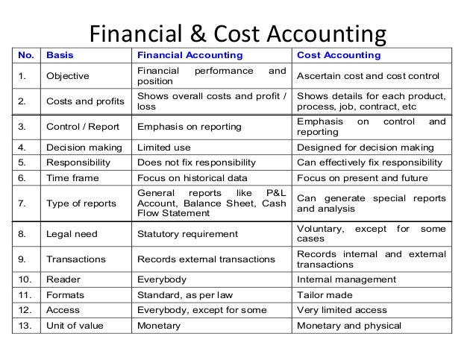
Differences between Financial Accounting and Cost Accounting

Slide 16
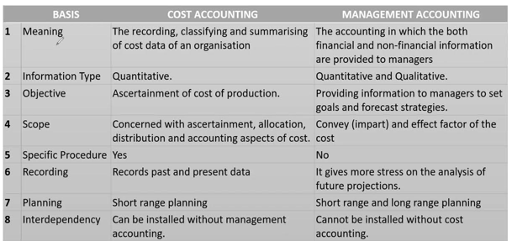
Differences between Cost Accounting and Management Accounting

Slide 17
Utility of Cost Accounting
The analysis of profitability of individual products, services or jobs.
The analysis of profitability of different departments or operations.
It locates differences between actual results and expected results.

Slide 18
Elements of Cost Accounting- Material
The substance from which the produce is made is called material. It can be direct as well as indirect.

Slide 19
Direct Material
it refers to those materials which become an integral part of the final product and can be easily traceable to specific physical units. Direct materials, thus, include:
All materials specifically purchased for a particular job or process.
Components purchased or produced.
Primary packing materials (e.g., carton, wrapping, card-board boxes etc.).
Material passing from one process to another.

Slide 20
Indirect Materials
All materials which are used for purpose ancillary to the business and which cannot conveniently be assigned to specific physical units are known as `indirect materials‟. Oil, grease, consumable stores, printing and stationery material etc. are a few examples of indirect materials.

Slide 21
Elements of Cost- Labour
In order to convert materials into finished products, human effort is required. Such human effort is known as labour.
Labour can be direct as well as indirect.

Slide 22
Direct Labour
It is defined as the wages paid to workers who are engaged in the production process and whose time can be conveniently and economically traceable to specific physical units. When a concern does not produce but instead renders a service, the term direct labour or wages refers to the cost of wages paid to those who directly carry out the service, e.g., wages paid to driver, conductor etc. Of a bus in transport service.

Slide 23
Indirect Labour
Labour employed for the purpose of carrying out tasks Incidental to goods produced or services provided is called indirect labour or indirect wages. In short, wages which cannot be directly identified with a job, process or operation, are generally treated as indirect wages. Examples of indirect labour are: wages of store-keepers, foremen, supervisors, inspectors, internal transport men etc.

Slide 24
Elements of Cost- Direct and Indirect Expenses
These are expenses which can be directly, conveniently and wholly identifiable with a job, process or operation. Direct expenses are also known as chargeable expenses or productive expenses. Examples of such expenses are: cost of special layout, design or drawings, hire of special machinery required for a particular contract, maintenance cost of special tools needed for a contract job, etc.
Expenses which cannot be charged to production directly and which are neither indirect materials nor indirect wages are known as indirect expenses. Examples are rent, rates and taxes, insurance, depreciation, repairs and maintenance, power, lighting and heating etc.

Slide 25
Overheads
The term overheads includes, indirect material, indirect labour and indirect expenses, explained in the preceding paragraphs. Overheads may be incurred in the factory, office or selling and distribution departments/ divisions in an undertaking. Thus overheads may be of three types: factory overheads, office and administrative overheads and selling and distribution overheads.

Slide 26
Classification of Overheads
Direct Overheads
Factory Overheads - Indirect
Office Overheads - Indirect
Selling distribution Overheads - Indirect

Slide 27
Historical Costs
Historical Costs: These costs are computed after they are incurred. Such costs are available only after the production of a particular thing is over.

Slide 28
Pre-Determined Costs
These costs are computed in advance of production on the basis of a specification of all factors influencing cost. Such costs may be:
Estimated costs: estimated costs are based on a lot of guess work. They try to ascertain what the costs will be based on certain factors. They are less accurate as only past experience is taken into account primarily, while computing them.
Standard costs: standard costs is a pre-determined cost based on a technical estimate for material, labour and other expenses for a selected period of time and for a prescribed set of working conditions. It is more scientific in nature and the object is to find out what the costs should be

Slide 29
Cost Classification by Traceability
Costs which can be easily traceable to a product are called direct costs. Indirect costs cannot be traced to a product or activity. They are common to several products
(e.g., salary of a factory manager, supervisor etc.) And they have to be apportioned to different products on some suitable basis. Indirect costs are also called “overheads”

Slide 30
Cost Classification in association with Product Cost
Product Costs: product costs are traceable to the product and include direct material, direct labour and manufacturing overheads. In other words, product cost is equivalent to factory cost.
Period Costs: period costs are charged to the period in which they are incurred and are treated as expenses. They are incurred on the basis of time, e.g., rent, salaries, insurance etc. They cannot be directly assigned to a product, as they are incurred for several products at a time (generally).

Slide 31
Cost Classification by Activity
Fixed Cost: Fixed cost is a cost which tends to be unaffected by variations in volume of output. Fixed cost mainly depends on the passage of time and does not vary directly with the volume of output. It is also called period cost, e.g., rent, insurance, depreciation of buildings etc. It must be noted here that fixed costs remain fixed upto a certain level only. These costs may also vary after a certain production level.

Slide 32
Cost Classification by Activity
Semi variable Cost- These costs are partly fixed and partly variable. Because of the variable element, they fluctuate with volume and because of the fixed element; they do not change in direct proportion to output. Semi-variable or semi-fixed costs change in the same direction as that of the output but not in the same proportion. For example, the expenditure on maintenance is to a great extent fixed if the output does not change significantly. Where, however, the production rises beyond a certain limit, further expenditure on maintenance will be necessary although the increase in the expenditure will not be in proportion to the rise in output. Other examples in this regard are: depreciation, telephone rent, repairs etc.

Slide 33
Cost Classification by Activity
Variable Cost- Cost which tends to vary directly with volume of outputs is called `variable cost‟. It is a direct cost. It includes direct material, direct labour, direct expenses etc. It should be noted here that the variable cost per unit is constant but the total cost changes corresponding to the levels of output. It is always expressed in terms of units, not in terms of time.

Slide 34
Cost Classification by Function
Manufacturing/Production Cost: it is the cost of operating the manufacturing division of an enterprise. It is defined as the cost of the sequence of operations which begin with supplying materials, services and ends with the primary packing of the product.
Administrative/Office Cost: it is the cost of formulating the policy, directing the organization and controlling the operations of an undertaking, which is not directly related to production, selling, distribution, research or development. Administration cost, thus, includes all office expenses: remuneration paid to managers, directors, legal expenses, depreciation of office premises etc.

Slide 35
Cost Classification by Function
Distribution Cost: it is the cost of the sequence of operations which begins with making the packed product, available for dispatch and ends with making the reconditioned returned empty package, if any, available for re-use. Thus, distribution cost includes all those expenses concerned with dispatching and delivering finished products to customers, e.g., warehouse rent, depreciation of delivery vehicles, special packing, loading expenses, carriage outward, salaries of dispatch clerks, repairing of empties for re-use, etc.

Slide 36
Cost Classification by Function
Research and Development Cost: It is the cost of discovering new ideas, processes, and products by experiment and implementing such results on a commercial basis.
Pre-Production Cost: Expenses incurred before a factory is started and expenses involved in introducing a new product are preproduction costs. They are treated as deferred revenue expenditure and charged to the cost of future production on some suitable basis.

Slide 37
Opportunity Cost and Sunk Cost
Opportunity Cost: It is the value of the benefit sacrificed in favor of choosing a particular alternative or action. It is the cost of the best alternative foregone. If an owned building, for example, is proposed to be used for a new project, the likely revenue which the building could fetch, when rented out, is the opportunity cost which should be considered while evaluating the profitability of the project.
Sunk Cost: A cost which was incurred or sunk in the past and is not relevant for decision-making is a sunk cost. It is only historical in nature and is irrelevant for decision-making. It may also be defined as the difference between the purchase price of an asset and its salvage value.

Slide 38
Class Exercise
Discuss the functions of Management Accounting and Cost Accounting (10 marks)
How cost classification can help in Decision making purpose? (10 marks)
Discuss the elements of cost accounting and their relevance (10 marks)
On what basis a cost can be categorized as fixed/ variable or semi-variable? Explain (5 marks)

